Slide 1
Survey of RDBMS vs. Graph Database Performance Using Time Series Data Manipulation
Paul Marquardt and Kristen Rollins

Slide 2
Problem Statement
We will test the suitability of an RDBMS system to manipulate times series data versus a graphing database to compare performance statistics.

Slide 3

Domain – Stock Data
American stock exchanges
AMEX, NASDAQ, NYSE

Slide 4
Application – Volatility Index Rating
Volatility Index (VIR)
“Volatility Index Graph”
Formula over previous 22 days:
VIR = (Highest Close – Current Low) / (Highest High) * 100

Slide 5
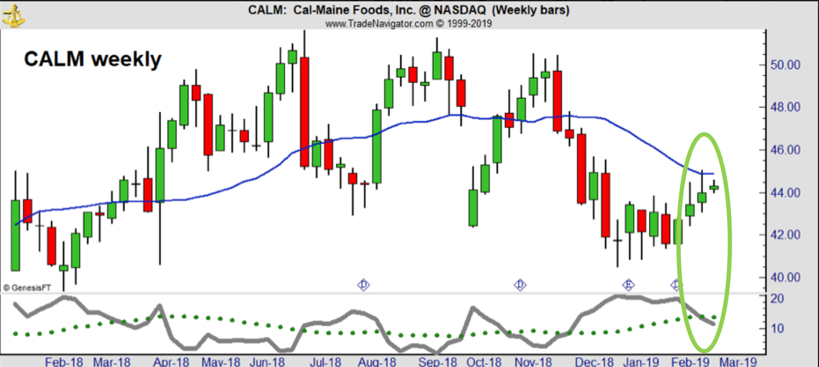
Application - VIR

Slide 6
Application - VIR

Slide 7
Obtaining Data
www.nasdaq.com for symbols and company info
Python script to pull historical data
Uses pandas_datareader library
Defines start/end dates
Appends Yahoo stock data to csv file

Slide 8
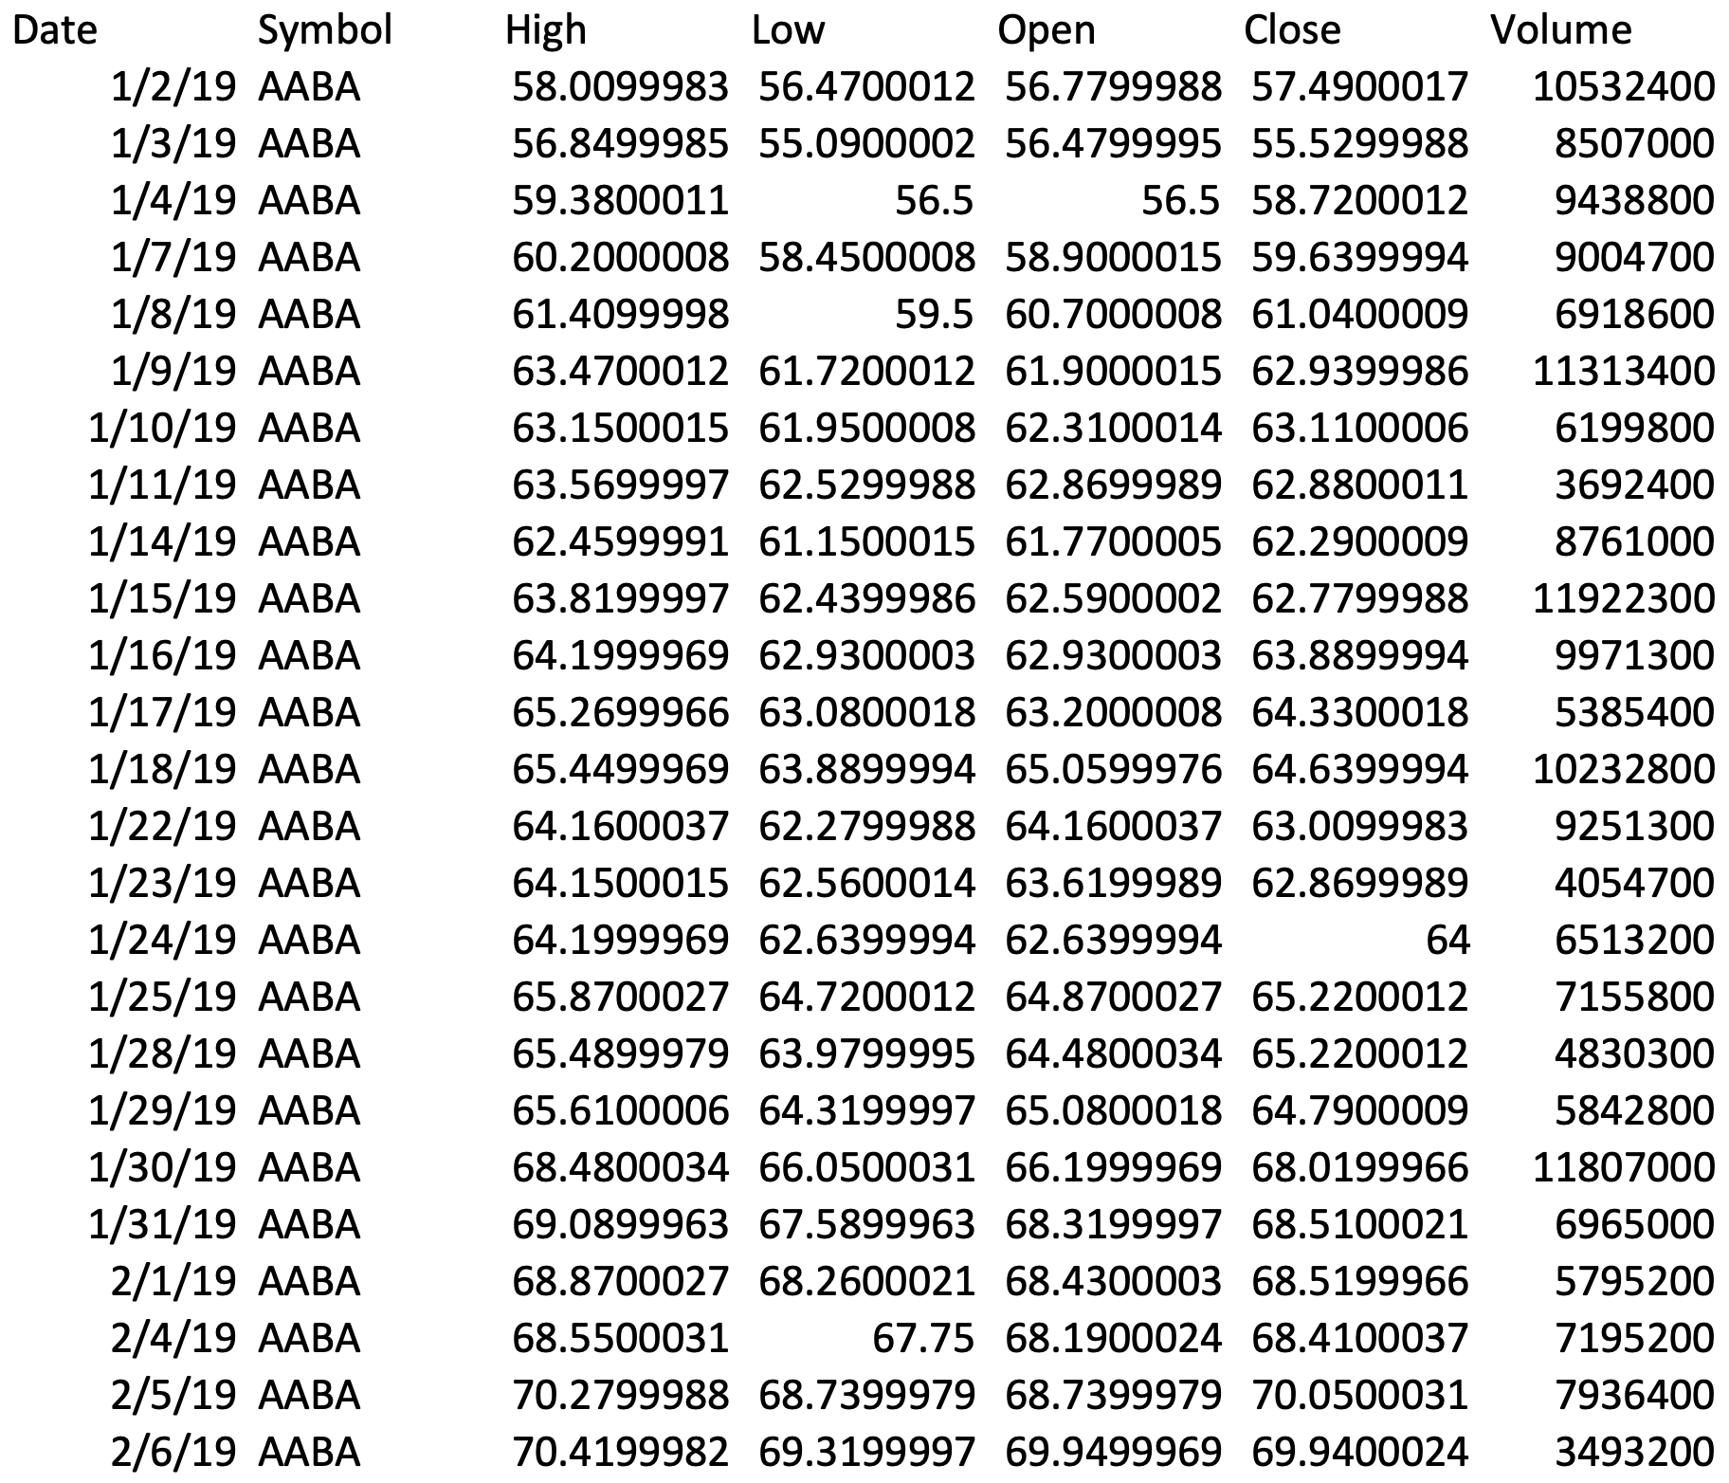
Raw Data

Slide 9

MySQL
Chosen relational DBMS
Familiar and free
Expectations
Not suitable for time series data
Slow queries (lots of joins)

Slide 10

Neo4j
Chosen graph DBMS
Most popular graph database
Open source
Easy setup
Expectations
More appropriate representation
Faster queries

Slide 11
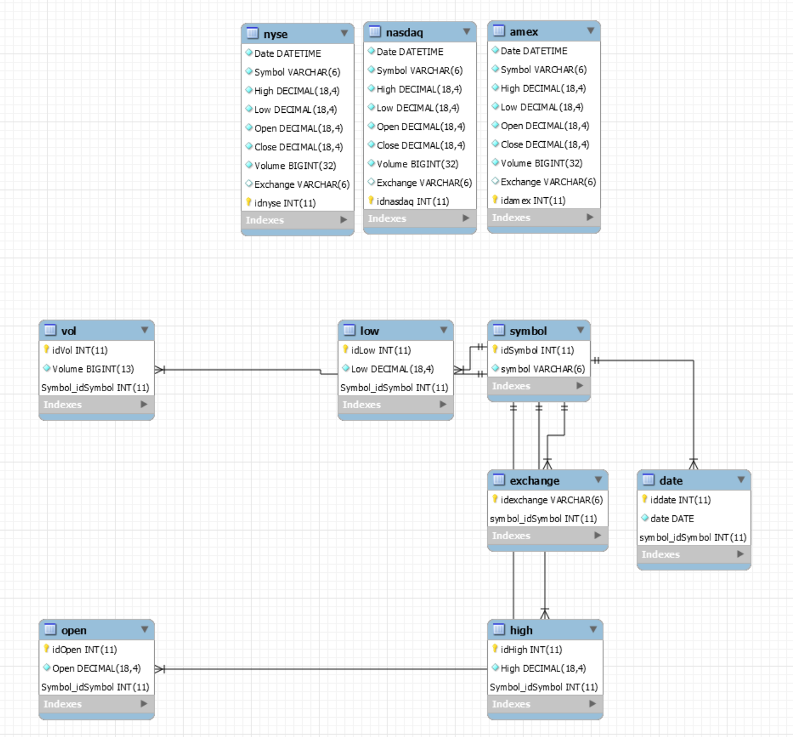
MySQL Data Model

Slide 12
MySQL Data Model

Slide 13
MySQL Next Steps
Add sample data to the database
Calculate VIR

Slide 14
Neo4j Basics
4 basic data constructs
Nodes
Relationships
Properties
Labels

Slide 15
Cypher Queries
Basic structure (reading data)
MATCH (m:Label1)-[:Relation]->(n:Label2)
RETURN m,n
Example
MATCH (d:Date)-[:Occurs]-(s)-[:Has]-(p)
WHERE (d.value="1/2/19" OR d.value="1/3/19”
OR d.value="1/4/19”)
AND (s.name="AABA" OR s.name="AAL”)
RETURN d,s,p

Slide 16
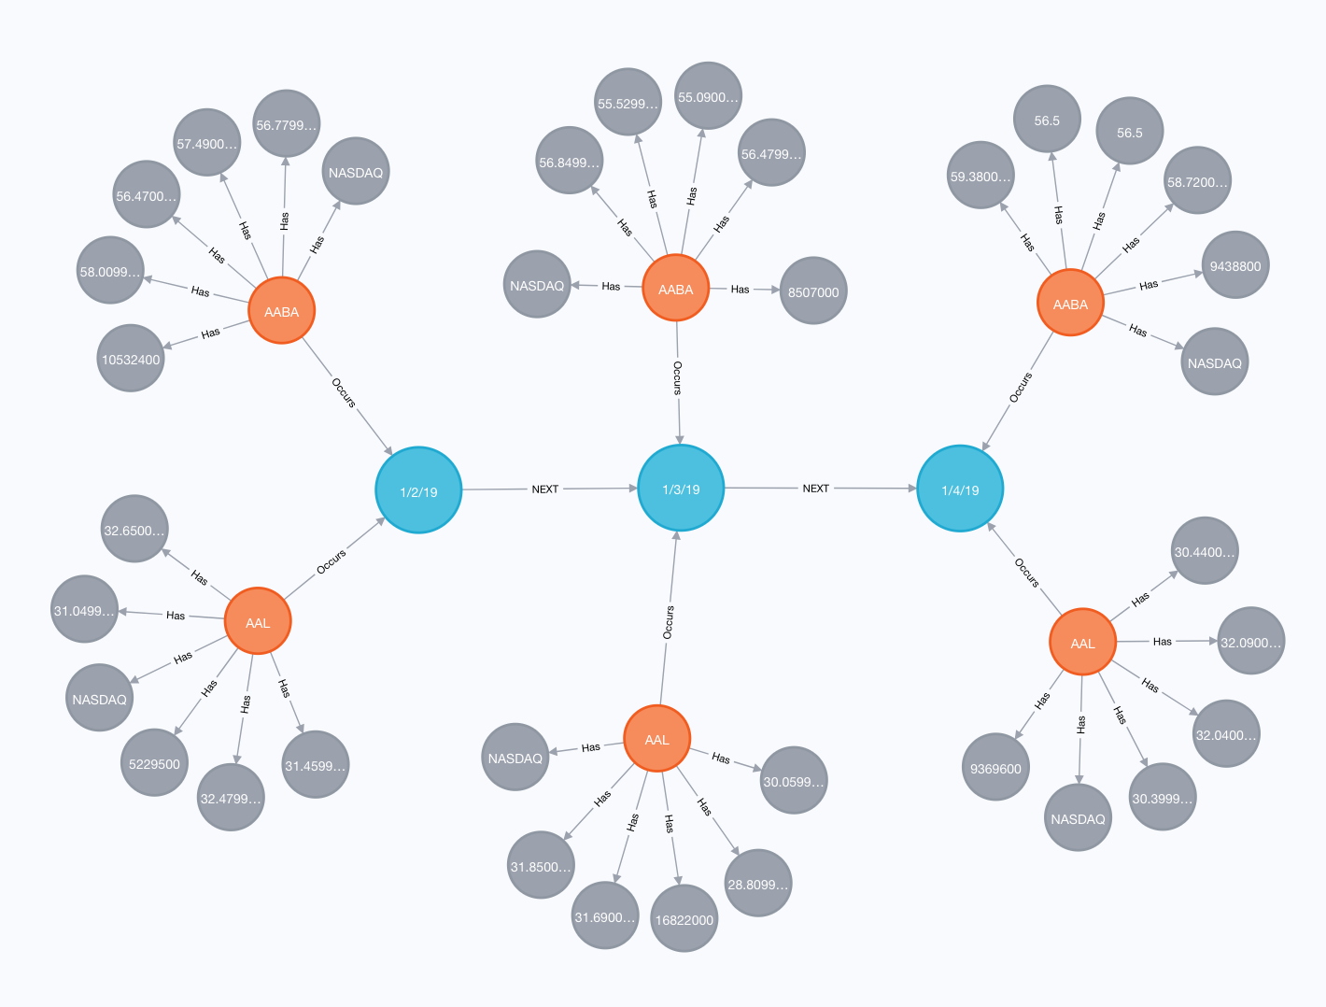
Neo4j Data Model

Slide 17
Neo4j Data Model

Slide 18
Neo4j Next Steps
Add sample data to the database
Calculate VIR

Slide 19
Performance Metrics
DMBS internal metrics
Execution time
Joins, temp tables
Nodes traversed
OS level metrics
CPU utilization
RAM usage
Disk usage

Slide 20
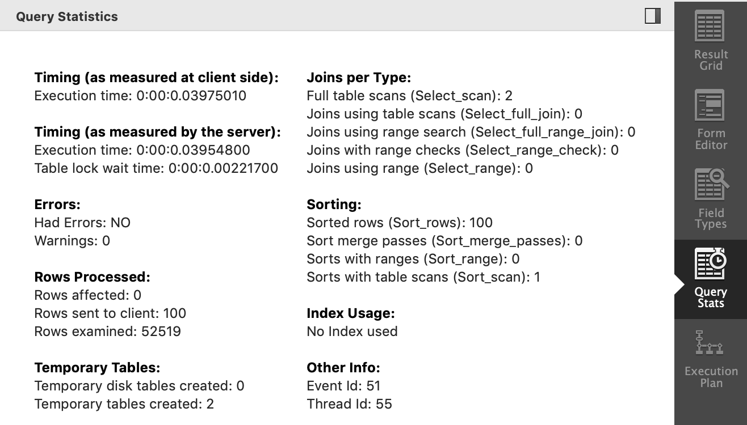
Obtaining Metrics
MySQL internal performance statistics
Neo4j internal performance statistics
Microsoft Performance Monitor

Slide 21
Summary
Volatility Index Rating
RDBMS (MySQL) vs Graph (Neo4j)
Suitability
Performance
Questions?

